Slide 1


Cloud Operations & Innovation (“CO+ I”)
A Feasibility Framework for Waste Heat from Data Centers to a Water Capture System from Uravu Labs
Milestone-3 Preliminary Report

Slide 2
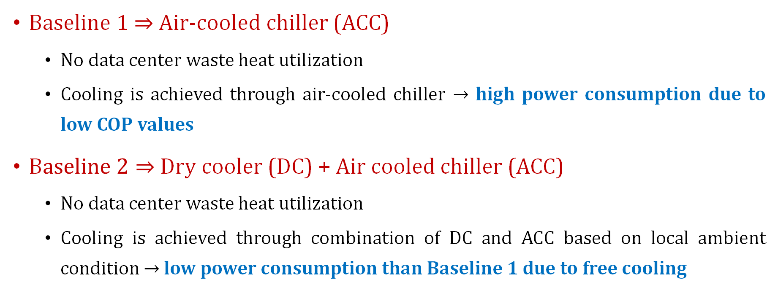
System Configurations
Baseline 1 $⇒$ Air-cooled chiller (ACC)
  No data center waste heat utilization
  Cooling is achieved through air-cooled chiller $→$ high power consumption due to low COP values
B$aseline 2⇒$ Dry cooler (DC) + Air cooled chiller (ACC)
  No data center waste heat utilization
  Cooling is achieved through combination of DC and ACC based on local ambient condition $→$ low power consumption than Baseline 1 due to free cooling

Slide 3
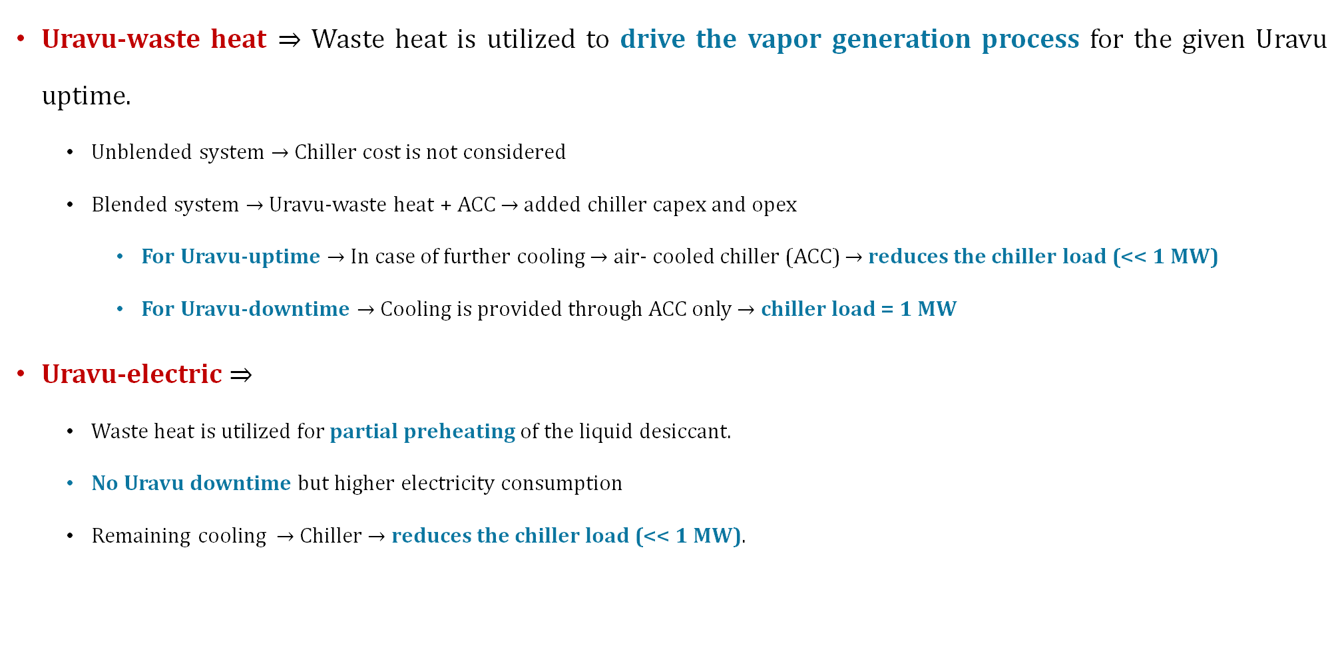
System Configurations
Uravu-waste heat $⇒$ Waste heat is utilized to drive the vapor generation process for the given Uravu uptime.
  Unblended system $→$ Chiller cost is not considered
  Blended system $→$ Uravu-waste heat + ACC $→$ added chiller capex and opex
    For Uravu-uptime $→$ In case of further cooling $→$ air- cooled chiller (ACC) $→$ reduces the chiller load (<< 1 MW)
    For Uravu-downtime $→$ Cooling is provided through ACC only $→$ chiller load = 1 MW
Uravu-electric $⇒$
  Waste heat is utilized for partial preheating of the liquid desiccant.
  No Uravu downtime but higher electricity consumption
  Remaining cooling $→$ Chiller $→$ reduces the chiller load (<< 1 MW).

Slide 4
Parameters | Value/source | Unit
Project lifetime | 15 | Years
Electricity cost | ~0.1–0.2 (source) | $/kWh
CAPEX (Uravu-waste heat) | ~500,000 | $/MW
CAPEX (Uravu-electric) | ~650,000 | $/MW
CAPEX (Air-cooled chiller) | ~350,000 | $/MW
CAPEX (Dry-cooler) | ~100,000 | $/MW
Maintenance rate (Uravu unit) | ~2 | %
Maintenance rate (Air-cooled chiller) | ~3 | %
Maintenance rate (Dry cooler) | ~2 | %
Power consumption (Uravu-waste heat) | ~50 | kW
Power consumption (Uravu-electric) | ~200 | kW
Power consumption (ACC) | ~333.33 | kW
Power consumption (DC) | ~45 | kW

Slide 5

Levelized Cost of Cooling (LCOC) - $/MWh
European Union
For Madrid at $30℃$:
Uravu-waste heat + ACC $≈$ Uravu-electric
At high-temperature waste heat for all cities:
Uravu-waste heat (unblended) << other configurations due to high uptime

Slide 6

United States
For Phoenix and Houston at $30℃$:
Uravu-waste heat + ACC $≈$ Uravu-electric
At high-temperature waste heat for all cities:
Uravu-waste heat (unblended) << other configurations due to high uptime

Slide 7
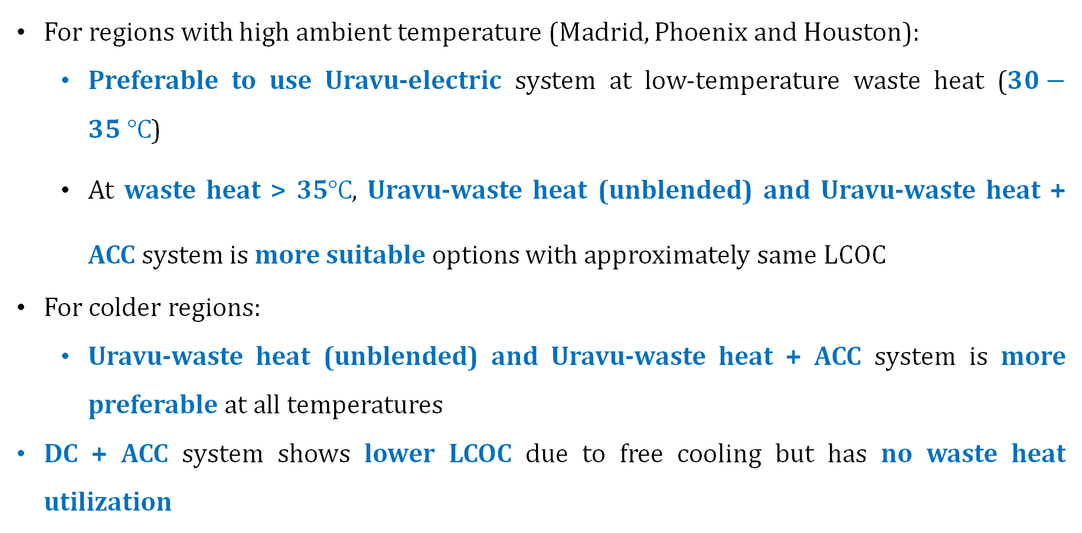
Key takeaways
For regions with high ambient temperature (Madrid, Phoenix and Houston):
  Preferable to use Uravu-electric system at low-temperature waste heat ($30−35 ℃$)
  At waste heat > 35$℃$, Uravu-waste heat (unblended) and Uravu-waste heat + ACC system is more suitable options with approximately same LCOC
For colder regions:
  Uravu-waste heat (unblended) and Uravu-waste heat + ACC system is more preferable at all temperatures
DC + ACC system shows lower LCOC due to free cooling but has no waste heat utilization

